Slide 1

Regional Climate Downscaling over
Western Maritime Continent
Fredolin Tangang, PhD
Professor,
Research Centre for Tropical Climate Change System (IKLIM),
Faculty of Science & Technology,
Universiti Kebangsaan Malaysia
(The National University of Malaysia)
Project Leader
Southeast Asia Regional Climate Downscaling (SEACLID) /
CORDEX SEA
IPCC Vice-Chair Working Group I

Slide 2
Outline
Introduction
Introduction to the Southeast Asia Regional Climate Downscaling (SEACLID) / CORDEX Southeast Asia Project
Regional climate downscaling using PRECIS over western Maritime Continent
Summary

Slide 3
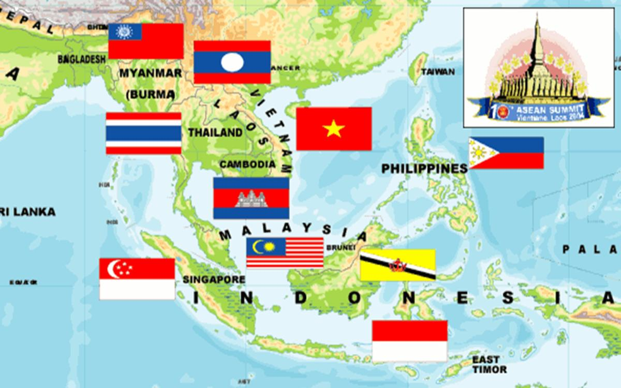
Southeast Asia Region
Countries: 11, Population: > ½ billion

Slide 4


Monsoon & Dominant Modes of Climate Variability
Description of slide / Title of slide
SWM (Late May to Sept)
NEM (Nov to March)
PACIFC OCEAN
MJO
ENSO
INDIAN OCEAN
IOD
Indian Ocean Dipole (IOD), El Nino-Southern Oscillation (ENSO) --IAV (2-7 years), Quasi-Biennial Oscillation (QBO), Madden-Julian Oscillation (MJO) – ISO (20-60 days), Synoptic scales – typhoon, cold surges, Borneo Vortex
UNIVERSITI KEBANGSAAN MALAYSIA

Slide 5
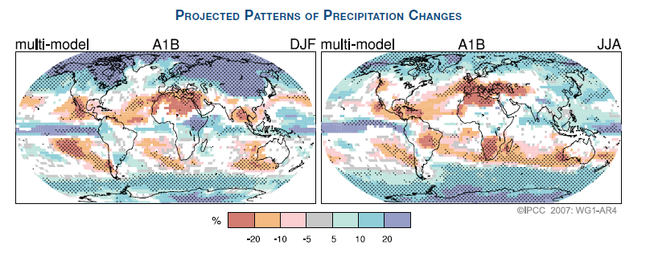
Projected Pattern of Precipitation Changes by 2100
IPCC AR4

Slide 6
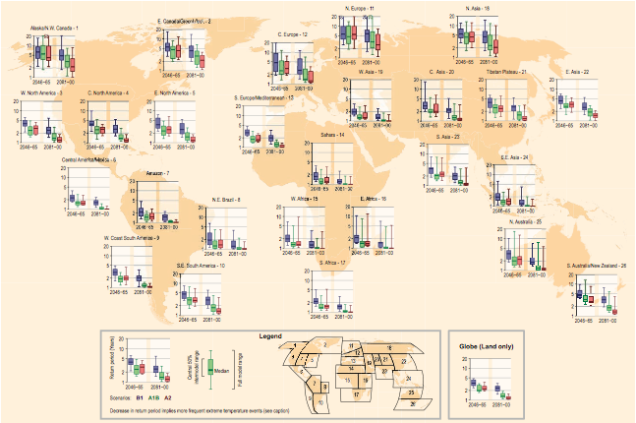
IPCC SREX: Climate & Weather Extremes
Projected return periods for maximum daily temperature that was exceeded on average once during a 20-period in 1981-2000
IPCC SREX 2010

Slide 7
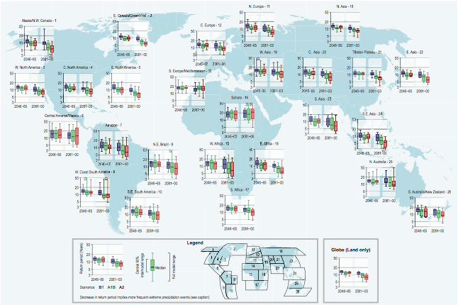
IPCC SREX: Climate & Weather Extremes
Projected return periods for a daily precipitation event that was exceeded on average once during a 20-period in 1981-2000
IPCC SREX 2010

Slide 8
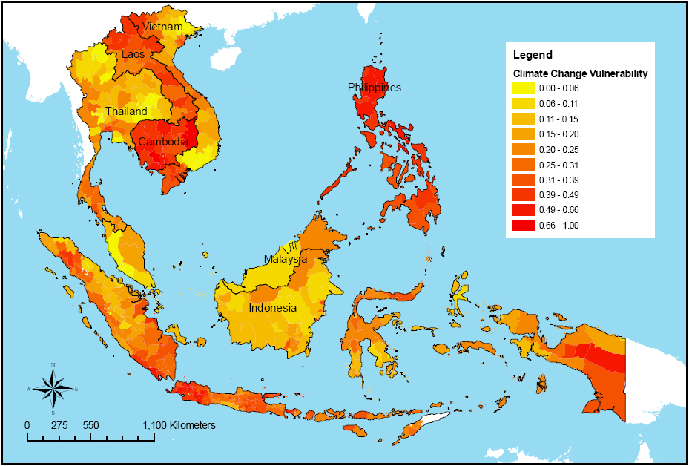
Different level of vulnerability to Climate change
Economy and Environment Program for Southeast Asia (EEPSEA) International Development Research Centre (http: //www.idrc.ca/eepsea)

Slide 9
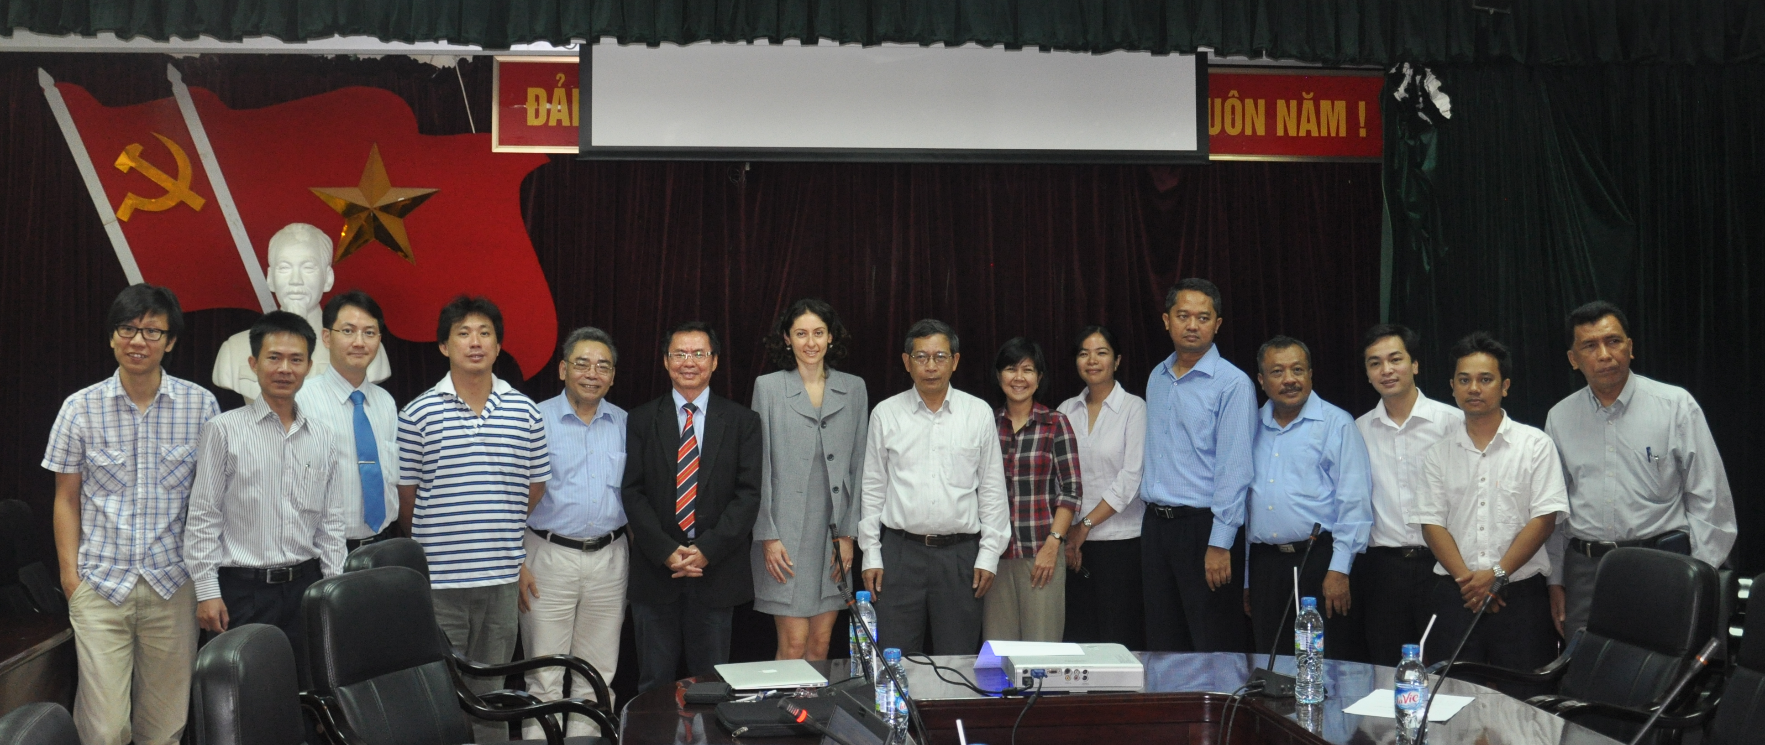
Southeast Asia Regional Climate Initiative (SEARCI)
Member Countries: Malaysia, Indonesia, Vietnam, Philippines, Thailand
Project Leader:
Fredolin Tangang
Natl Univ of Malaysia
Hanoi University of Science, Vietnam, 2-3 Aug 2012

Slide 10
Southeast Asia Regional Climate Downscaling (SEACLID) Project
5+2 countries (Cambodia, Lao PDR)
Secured APN funding for 3 years
(OCT 2013- SEPT 2016)
5 CMIP5 GCMs, 3 RCPs (4.5, 6.0, 8.5)
RCM: RegCM4, Resolution: 36 km
Downscaling tasks will be distributed among country members
Capacity building
Scientific publication
Establish data center
Engagement with users / stakeholders / policy makers

Slide 11
Latest developments
SEACLID is now CORDEX-Southeast Asia (CORDEX-SEA)
Domain: Same, Resolution: 25 km,
RCM: RegCM4, GCM: 5 or more
RCP: 4.5, 8.5
Currently completing sensitivity experiments for physics options
Require other institutions to participate in CORDEX-SEA & increase ensemble members with different RCM & GCM

Slide 12
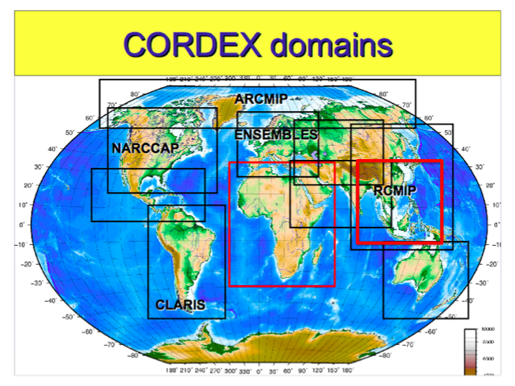
SEACLID

Slide 13
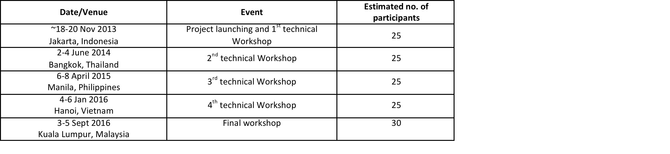
Tentative Dates for SEACLID / CORDEX-SEA Workshop
International Workshop on Regional Climate Downscaling & CORDEX Coordination Meeting, NOV 2013, CITEKO, INDONESIA

Slide 14
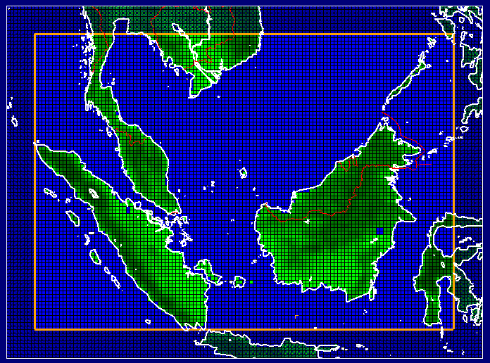
PRECIS Simulation domain
RCM: HadRM3P
Resolution:
0.22°× 0.22°
BC: ERA40,
HadAM3P, HadCM3
ECHAM5
HadCM3
(1970-2100)
100
137

Slide 15
Annual cycle of Mean Surface Temperature

Slide 16
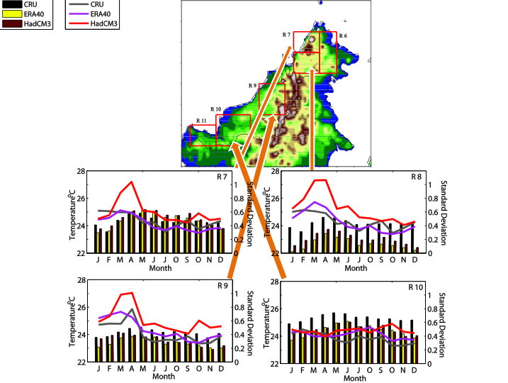

Slide 17
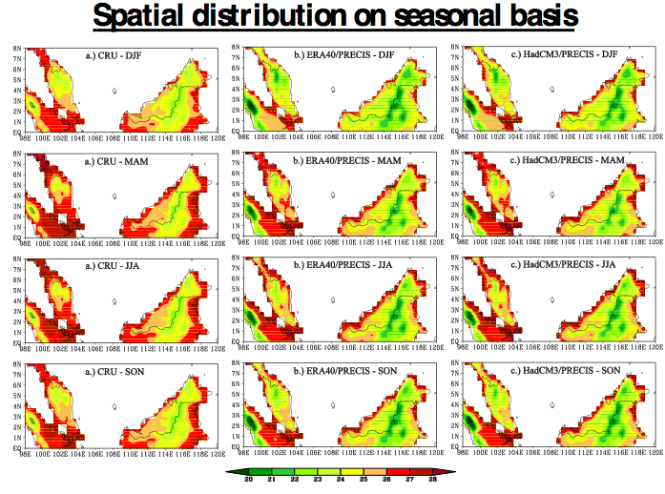
Spatial Distribution of Mean Surface Temperature

Slide 18
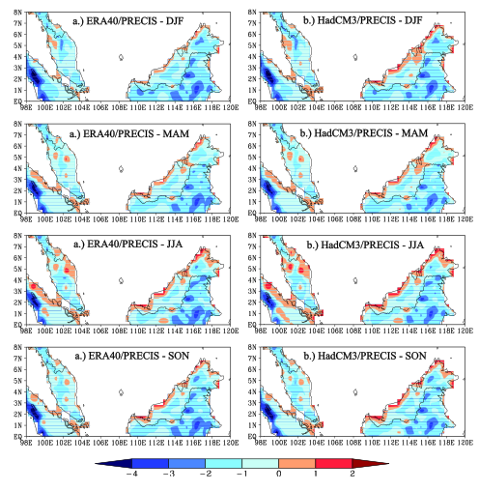
Spatial Distribution of Biases
Due to GCM, RCM or CRU?

Slide 19
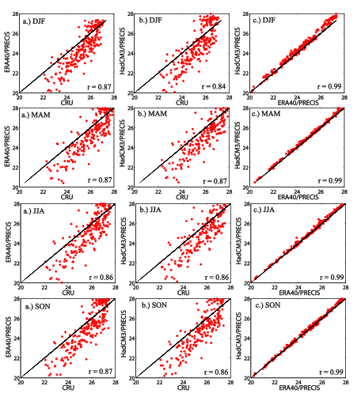
Grid to grid correlation
Biases associated with CRU or RCM?

Slide 20
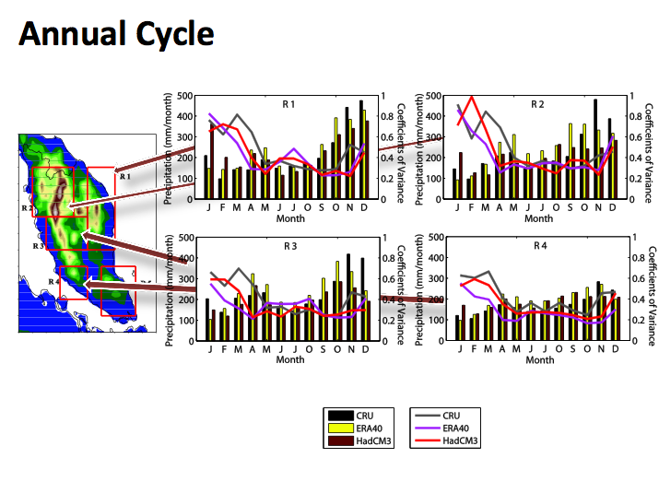
Annual cycle of Mean Precipitation

Slide 21
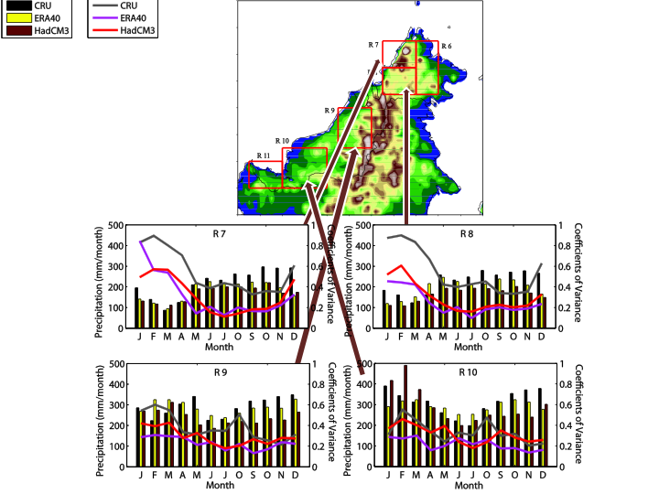

Slide 22
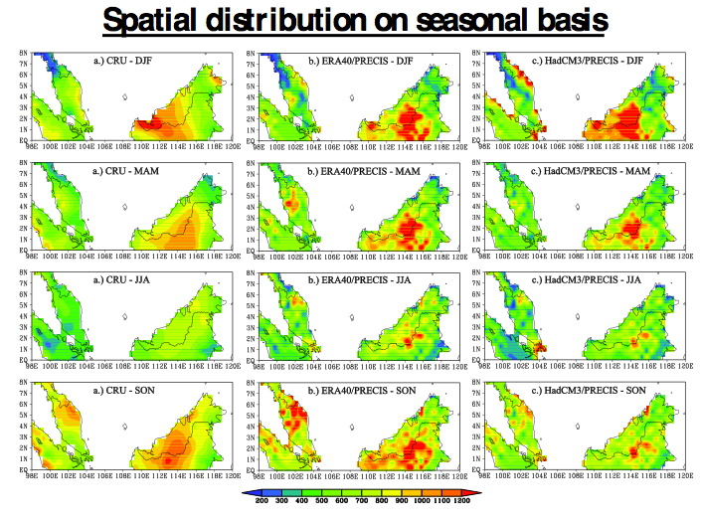
Spatial Distribution of Mean Precipitation

Slide 23
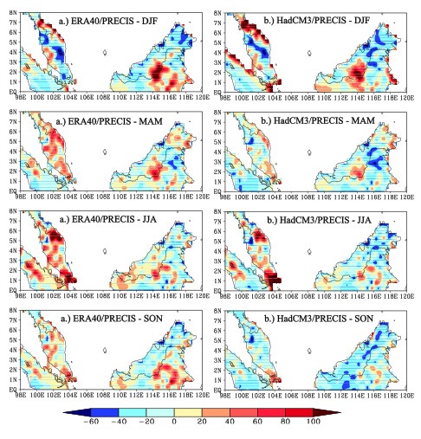
Biases based on comparison with CRU data

Slide 24
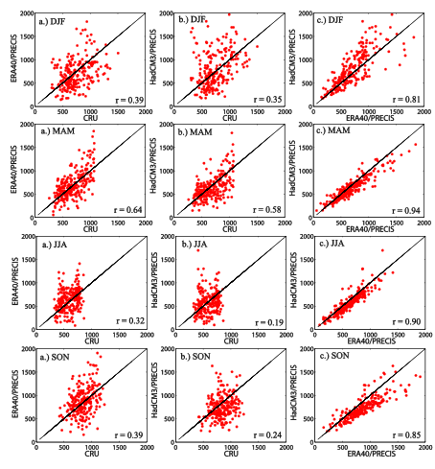
Biases associated with CRU or RCM?

Slide 25
Application of a bias-correction technique on PRECIS output.

Slide 26
Bias Correction
Numerous bias correction algorithms.
In this study we adopted a quantile-mapping method (Hashino et al. 2007)
Bias correction may work if the error is time-invariant & associated with model deficiency (e.g. inability to resolve complex topography)
Bias correction requires reliable dataset
In this study we use:
  APHRODITE_MYS (0.05 x 0.05, daily precip) (Yatagai et al. 2012)
  WONG2010 (0.05 x 0.05, daily temp Peninsular Malaysia (Wong 2010)

Slide 27
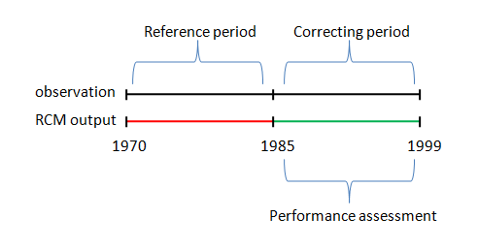
Validation of the bias correction algorithm.
PRECIS/ERA40 were first interpolated onto the observation 0.05 x 0.05 grid.
The output of the PRECIS/ERA40 were divided into two non-overlapping period of
i) 1970 to 1984 (reference period)
ii) 1985 – 1999 (validation period)

Slide 28
A grid-by-grid assessment on of the following statistics were performed on both the precipitation and temperature:
Seasonal mean
Seasonal 90th percentile
Seasonal averaged intensity (for precipitation)

Slide 29
Bias correction validation for daily precipitation

Slide 30
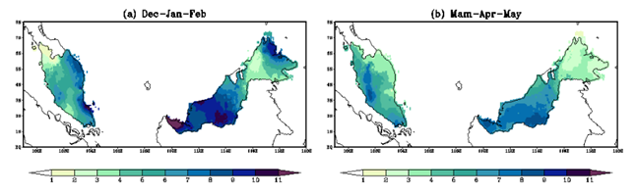
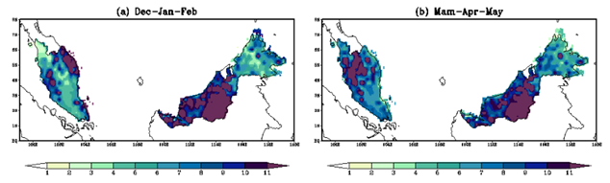
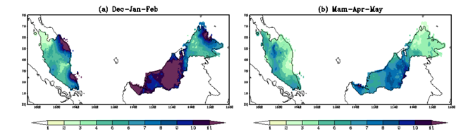
Dec-Jan-Feb
Mar-Apr-May
APHRODITE_MYS
PRECIS (Raw)
PRECIS
(Bias Corrected)
The PRECIS simulation produces more rainfall although the general spatial variations are correctly reproduced.
The bias correction generally corrected the magnitude but large errors persist over the central Sarawak where large rainfall amount was recorded

Slide 31
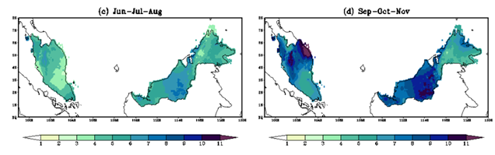
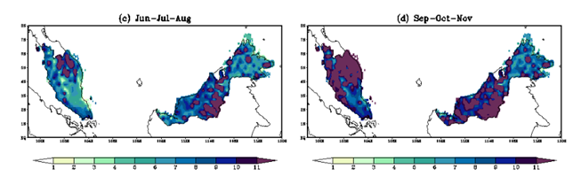
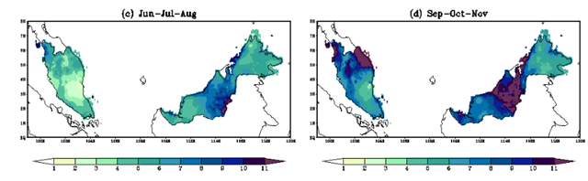
Jun-Jul-Aug
Sep-Oct-Nov
APHRODITE_MYS
PRECIS (Raw)
PRECIS
(Bias Corrected)
Fig. Comparison of mean seasonal rainfall (unit: mm/day) for DJF and MAM.

Slide 32
The spatial MAE (1986-1999) for the seasonal mean of daily rainfall (unit: mm/day) with reference to the values calculated from the 0.05°×0.05° version of the APHRODITE_MYS before and after the application of the developed bias correction algorithm
Seasons | Peninsular Malaysia |  | East Malaysia
 | Before Correction | After Correction | Before Correction | After Correction
Dec-Jan-Feb | 2.14 | 1.04 (51%) | 3.37 | 2.21 (34%)
Mar-Apr-May | 3.29 | 0.69 (79%) | 3.86 | 0.85 (77%)
Jun-Jul-Aug | 3.07 | 0.63 (79%) | 3.05 | 0.93 (69%)
Sep-Oct-Nov | 4.03 | 1.04 (74%) | 3.01 | 1.14 (62%)

Slide 33
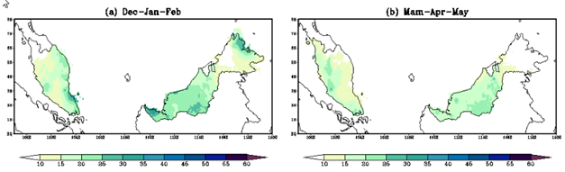
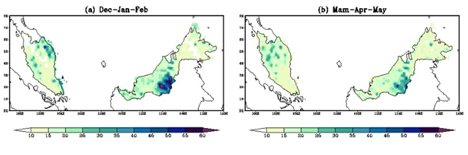
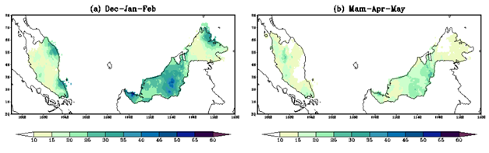
Dec-Jan-Feb
Mar-Apr-May
APHRODITE_MYS
PRECIS (Raw)
PRECIS
(Bias Corrected)
Fig. Comparison of daily rainfall 90th percentile for DJF and MAM.

Slide 34
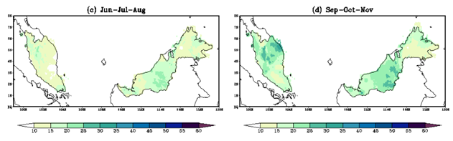
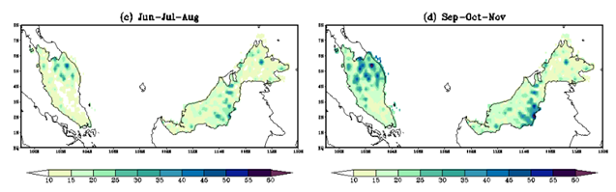
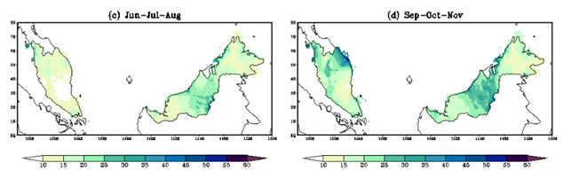
Jun-Jul-Aug
Sep-Oct-Nov
APHRODITE_MYS
PRECIS (Raw)
PRECIS
(Bias Corrected)
Fig. Comparison of daily rainfall 90th percentile for JJA and SON.

Slide 35
The spatial MAE (1986-1999) for the 90th percentile daily rainfall (unit: mm/day) with reference to the values calculated from the 0.05°×0.05° version of the APHRODITE_MYS before and after the application of the developed bias correction algorithm.
Seasons | Peninsular Malaysia |  | East Malaysia
 | Before Correction | After Correction | Before Correction | After Correction
Dec-Jan-Feb | 4.61 | 2.40 (47%) | 6.08 | 5.60 (7%)
Mar-Apr-May | 3.97 | 1.98 (50%) | 4.28 | 2.23 (47%)
Jun-Jul-Aug | 3.24 | 1.99 (38%) | 3.48 | 2.32 (33%)
Sep-Oct-Nov | 4.27 | 3.06 (28%) | 4.73 | 2.72 (42%)

Slide 36
Bias correction Validation for temperature distribution

Slide 37
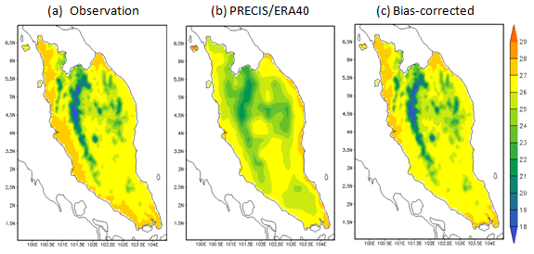
The spatial distribution of the annual mean temperature (1986-1999) for (a) observation, (b) the raw PRECIS/ERA40 and (c) after the bias correction. Unit in °C.
Too cold
Too warm

Slide 38
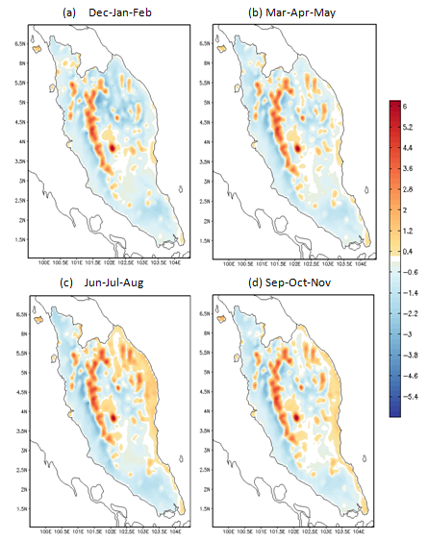
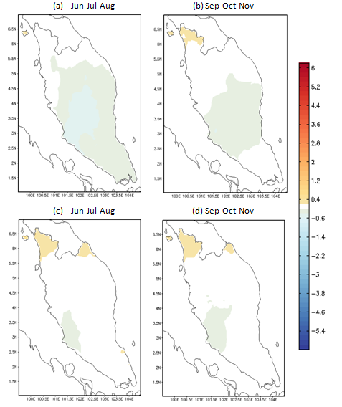
The seasonal variations of mean temperature biases
Biases of PRECIS/ERA40
Biases of PRECIS/ERA40 after correction

Slide 39
The spatial MAE (1985-1999) for the seasonal averaged temperature (unit: °C) with reference to the values calculated from the WONG2010 before and after the application of the developed bias correction algorithm. The values in the bracket show percentage of improvement.
Seasons | Before correction | After correction
Dec-Jan-Feb | 0.95 | 0.29 (69%)
Mar-Apr-May | 0.89 | 0.19 (79%)
Jun-Jul-Aug | 0.99 | 0.11 (89%)
Sep-Oct-Nov | 0.90 | 0.12 (87%)

Slide 40
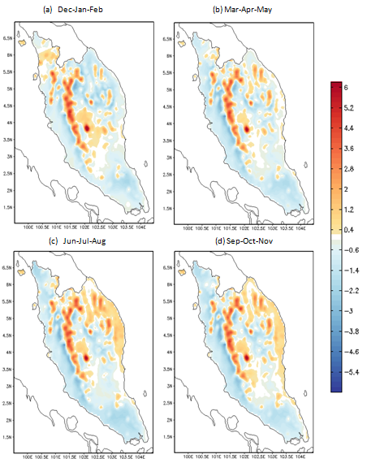
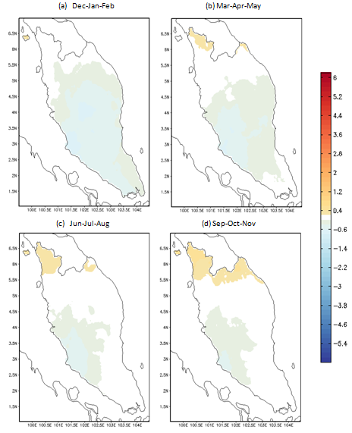
The seasonal variations of the 90th percentile daily temperature biases
Biases of PRECIS/ERA40
Biases of PRECIS/ERA40 after correction

Slide 41
Seasonal variations of the daily temperature 90th percentile mean absolute errors over the Peninsular Malaysia calculated over the validation period of 1985-1999
 | Before correction | After correction
Dec-Jan-Feb | 0.88 | 0.37 (57%)
Mar-Apr-May | 0.92 | 0.25 (72%)
Jun-Jul-Aug | 1.03 | 0.17 (83%)
Sep-Oct-Nov | 0.97 | 0.17 (82%)

Slide 42
Future changes of daily rainfall and temperature characteristics from the PRECIS/HadCM3 (Bias-Corrected) SRES A1B simulation

Slide 43
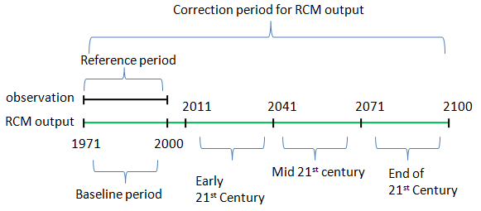
PRECIS/HadCM3 SRES A1B Scenario
The PRECIS/HadCM3 is a transient simulations and produce output from January 1970 – December 2100. The reference period for correction factors calculation were 1971-2000.

Slide 44
Precipitation Changes
The changes (on seasonal basis) were calculated for three separate future periods, namely 2011-2040, 2041-2070 and 2071-2100 from the bias corrected dataset.
- mean precipitation
- 90th percentile of daily precipitation
- simple daily intensity

Slide 45
Table: Changes of seasonal mean of daily precipitation averaged over Peninsular Malaysia w.r.t the baseline period of 1970-2000. Values in the bracket show the standard deviation about the mean values. Unit is %.
Season | 2011 – 2040 | 2041 – 2070 | 2071 – 2100
Dec-Jan-Feb | -10 (9) | - 18.9 (6) | - 15 (8.2)
Mar-Apr-May | 2.3 (7.1) | - 9.2 (8.8) | - 3.6 (11.7)
Jun-Jul-Aug | -5 (8.3) | 6.2 (15.4) | - 8 (17)
Sep-Oct-Nov | 9.7 (5.2) | 15.5 (8.1) | 15.8 (11)
Changes of seasonal mean of daily precipitation averaged over Sabah and Sarawak w.r.t the baseline period of 1970-2000. Values in the bracket show the standard deviation about the mean values. Unit is %.
Season | 2011 – 2040 | 2041 – 2070 | 2071 – 2100
Dec-Jan-Feb | - 3.5 (7.2) | - 12.6 (9.8) | - 6.6 (9.3)
Mar-Apr-May | 5 (8.7) | - 2.6 (18.4) | 3 (23.3)
Jun-Jul-Aug | 9.5 (14.5) | 35.5 (28.4) | 25.3 (25.2)
Sep-Oct-Nov | 6 (8.3) | 6.1 (10.7) | 14 (13.6)

Slide 46
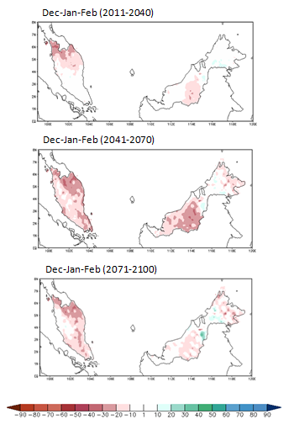
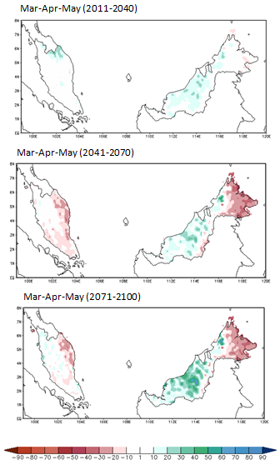
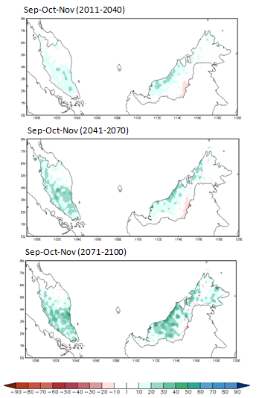
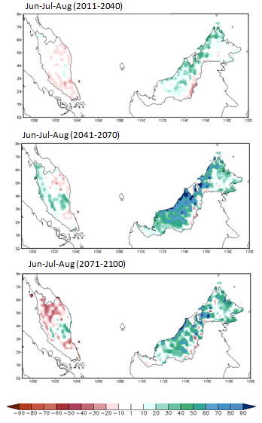
Changes of seasonal mean precipitation
Dec-Jan-Feb
Mar-Apr-May
Jun-Jul-Aug
Sep-Oct-Nov
2011
- 2040
2041
- 2070
2071
- 2100

Slide 47
Changes of seasonal 90th percentile of daily precipitation averaged over Peninsular Malaysia w.r.t the baseline period of 1970-2000. Values in the bracket show the standard deviation about the mean values. Unit is %.
Season | 2011 – 2040 | 2041 – 2070 | 2071 – 2100
Dec-Jan-Feb | -8.3 (12) | -15 (8.8) | - 12 (11.2)
Mar-Apr-May | 1.7 (6.9) | -7 (11.5) | - 0.9 (14)
Jun-Jul-Aug | - 3.6 (8.9) | 9.8 (17) | 0.03 (18)
Sep-Oct-Nov | 9 (7.3) | 16.3 (10) | 16.4 (13.2)
Changes of seasonal 90th percentile of daily precipitation averaged over Sabah and Sarawak w.r.t the baseline period of 1970-2000. Values in the bracket show the standard deviation about the mean values. Unit is %.
Season | 2011 – 2040 | 2041 – 2070 | 2071 – 2100
DJF Areal Average | -3 (8.4) | -8.8 (12.7) | -2.3 (12.2)
MAM Areal Average | 6 (9.3) | 0.9 (18.1) | 7.5 (21.5)
JJA Areal Average | 11.5 (14.9) | 41.3 (28.9) | 35.8 (27.5)
SON Areal Average | 4.7 (8.1) | 7.3 910) | 14.9 (12.6)

Slide 48
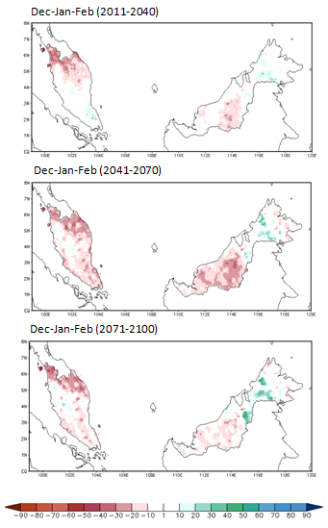
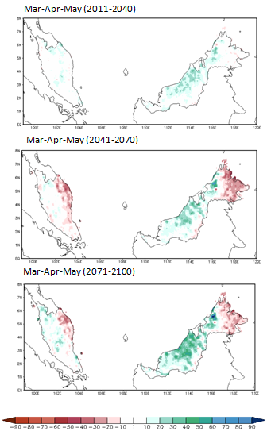
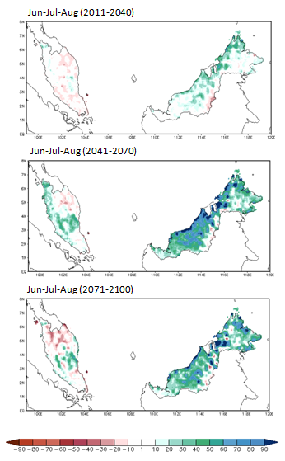
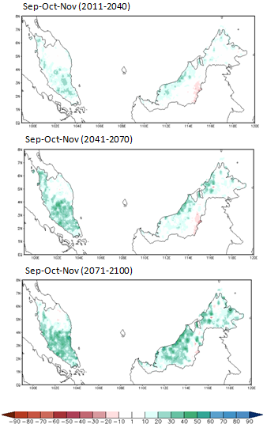

Changes of seasonal 90th percentile of daily precipitation
Dec-Jan-Feb
Mar-Apr-May
Jun-Jul-Aug
Sep-Oct-Nov
2011
- 2040
2041
- 2070
2071
- 2100

Slide 49
Changes of seasonal daily precipitation intensity averaged over Peninsular Malaysia w.r.t the baseline period of 1970-2000. Values in the bracket show the standard deviation about the mean values. Unit is %.
Season | 2011 – 2040 | 2041 – 2070 | 2071 – 2100
Dec-Jan-Feb | 0.8 (6.6) | 1.7 (6.6) | 0.4 (7.7)
Mar-Apr-May | 10.5 (8.6) | 4.3 (5.6) | 6.5 (8.4)
Jun-Jul-Aug | 3.7 (7.2) | 12.2 (13.4) | 11.4 (15.2)
Sep-Oct-Nov | 9.2 (5.1) | 14.1 (8.3) | 15.8 (10.3)
Changes of seasonal daily precipitation intensity averaged over Sabah and Sarawak w.r.t the baseline period of 1970-2000. Values in the bracket show the standard deviation about the mean values. Unit is %.
Season | 2011 – 2040 | 2041 – 2070 | 2071 – 2100
Dec-Jan-Feb | 0.3 (7.6) | - 0.4 (11.5) | 6.8 (11.8)
Mar-Apr-May | 8.8 (6.3) | 8 (10.9) | 16.1 (15.1)
Jun-Jul-Aug | 10.7 (10.5) | 37.6 (19.6) | 35.6 (18.4)
Sep-Oct-Nov | 6.7 (7.6) | 10 (9) | 17.9 (11.9)

Slide 50
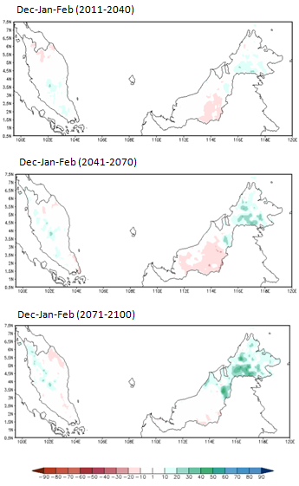
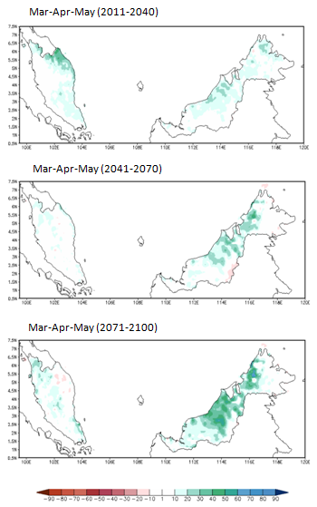
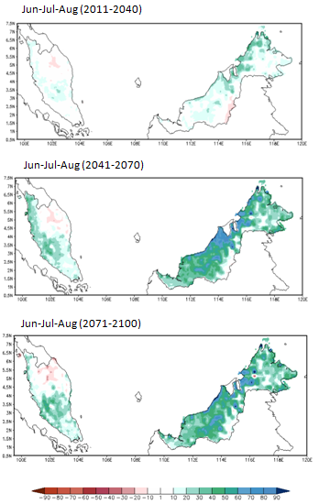
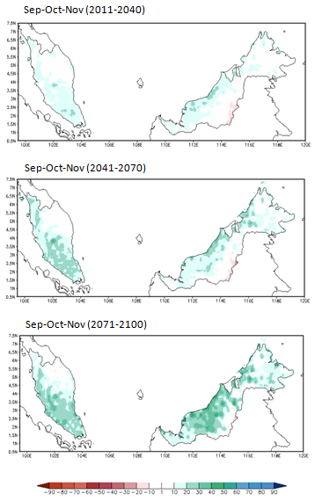
Changes of seasonal daily precipitation intensity (SDI)
Dec-Jan-Feb
Mar-Apr-May
Jun-Jul-Aug
Sep-Oct-Nov
2011
- 2040
2041
- 2070
2071
- 2100

Slide 51
Temperature Changes
The changes of temperature on seasonal basis were calculated for three separate future periods, namely 2011-2040, 2041-2070 and 2071-2100 from the bias corrected dataset.
- seasonal mean temperature
- 90th percentile of daily precipitation
Only the changes over Peninsular Malaysia were presented since the 5km × 5 km bias corrected output is only available for these areas.

Slide 52
Changes of seasonal mean daily temperature averaged over Peninsular Malaysia w.r.t the baseline period of 1970-2000. Values in the bracket show the standard deviation about the mean values. Unit is °C
 | 2011-2040 | 2041-2070 | 2071-2100
Dec-Jan-Feb | 1.1 (0.07) | 2.2 (0.13) | 2.9 (0.15)
Mar-Apr-May | 1.4 (0.09) | 2.6 (0.17) | 3.4 (0.24)
Jun-Jul-Aug | 1.6 (0.15) | 2.7 (0.21) | 3.7 (0.23)
Sep-Oct-Nov | 1.2 (0.10) | 2.3 (0.20) | 3.2 (0.30)

Slide 53
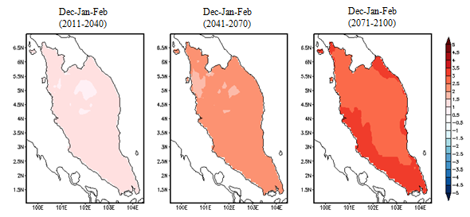


The changes of Dec-Jan-Feb and Jun-Jul-Aug mean temperature with respect to the baseline period of 1970-2000 as projected by the PRECIS/HadCM3 based on SRES A1B scenario

Slide 54
Changes of seasonal 90th percentile of daily temperature over Peninsular Malaysia w.r.t the baseline period of 1970-2000. Values in the bracket show the standard deviation about the mean values. Unit is °C.
Seasons | 2011 – 2040 | 2041 – 2070 | 2071 – 2100
Dec-Jan-Feb | 1.3 (0.12) | 2.4 (0.14) | 3.1 (0.18)
Mar-Apr-May | 1.5 (0.15) | 2.7 (0.26) | 3.6 (0.31)
Jun-Jul-Aug | 1.6 (0.23) | 2.5 (0.29) | 3.6 (0.36)
Sep-Oct-Nov | 1.3 (0.16) | 2.4 (0.32) | 3.3 (0.39)

Slide 55


Changes of 90th percentile of the daily temperature during Dec-Jan-Feb and Jun-Jul-Aug with respect to the baseline period of 1970-2000 as projected by the PRECIS/HadCM3 based on SRES A1B scenario

Slide 56
Summary
The PRECIS provides reasonable simulation over western Maritime Continent but with systematic biases
We show here that these biases are largely correctable using a bias correction technique
This work is a consultation project for the Malaysian Government
In the next 3 years more regional downscaling work over the Southeast Asia region would be carried out under the SEACLID/CORDEX-SEA

Slide 57
Thank You

